Slide 1
Cloud backed Android Apps & more…
Aniruddh Bajirao (Match.com)
12th October 2013 – Big Android BBQ

Slide 2
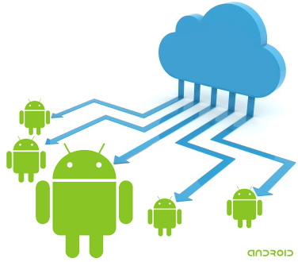

Slide 3
Why, What, How…
Client server apps to augment already existing web apps (Match.com, Google+, Facebook, Twitter)
Sync your data
Apps that get data from a server

Slide 4
Build an API (RESTful web service) … if you don’t already have one!

Slide 5


Application Server
API Backend
Datastore

Slide 6
What do I really need?
CRUD
Push Notifications
Scalable
Easy to Deploy
Authentication
&
Authorization
SQL & NoSQL

Slide 7
Do I have to write my own backend?
Google Mobile Backend
Azure Mobile Services
Backendless
Open Mobster
How about writing your own…
Play Framework
Google App Engine
ASP.net WebApi

Slide 8
Need some more REST
Representational State Transfer
HTTP methods GET, POST, PUT and DELETE
Client–server
Stateless

Slide 9
Build the App

Slide 10
Android
Bookmarks Sync App
Add a book
Add a bookmark
Delete a bookmark
Multiple screen sizes
Multiple resolutions
Fragments, more fragments…

Slide 11
Leverage the Android Platform
Use the platform features (Content Providers, Services, GCM, AccountManager, Notifications)
Modularize your app
Use Fragments
Single app for phone and tablets
Use common UX patterns so you don’t have to re-train your users

Slide 12
Fragment
ListAdaptor
Service
ArrayList<Objects>
REST Method
CursorLoader
Processor
ContentProvider
Db

Slide 13
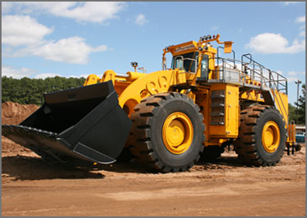

Loaders
Loaders load data(objects) from some source (disk, Db, network…)
AsyncTaskLoaders
CursorLoaders
A loader that queries the ContentResolver and returns a Cursor.
Implements the Loader protocol for querying cursors, building on AsyncTaskLoader to
Perform the cursor query on a background thread

Slide 14
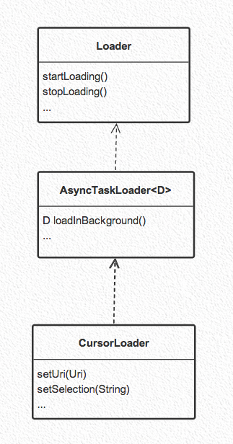

Slide 15
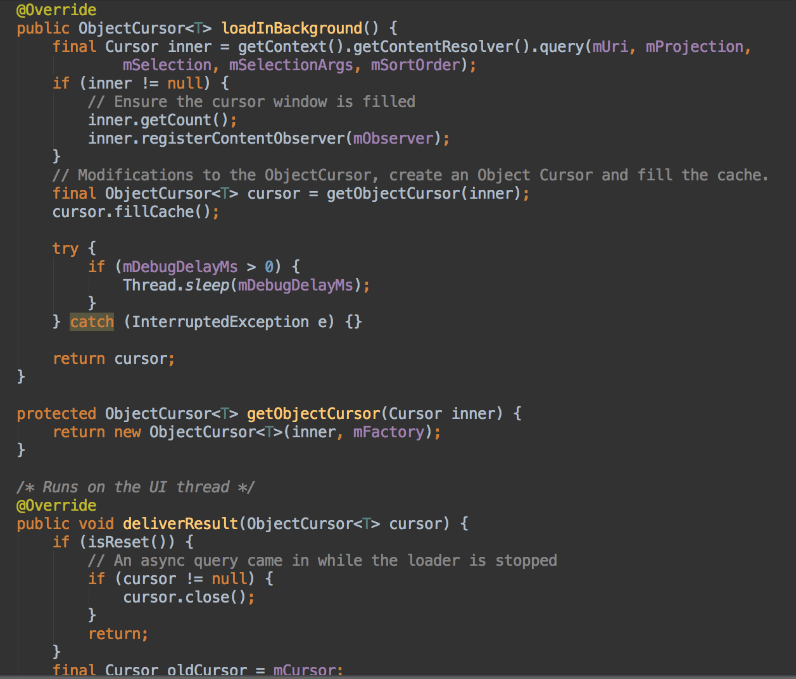
Object arrays backed by Cursors
Useful when each row returns an object
Easy to manipulate objects from the adapter
Good caching

Slide 16
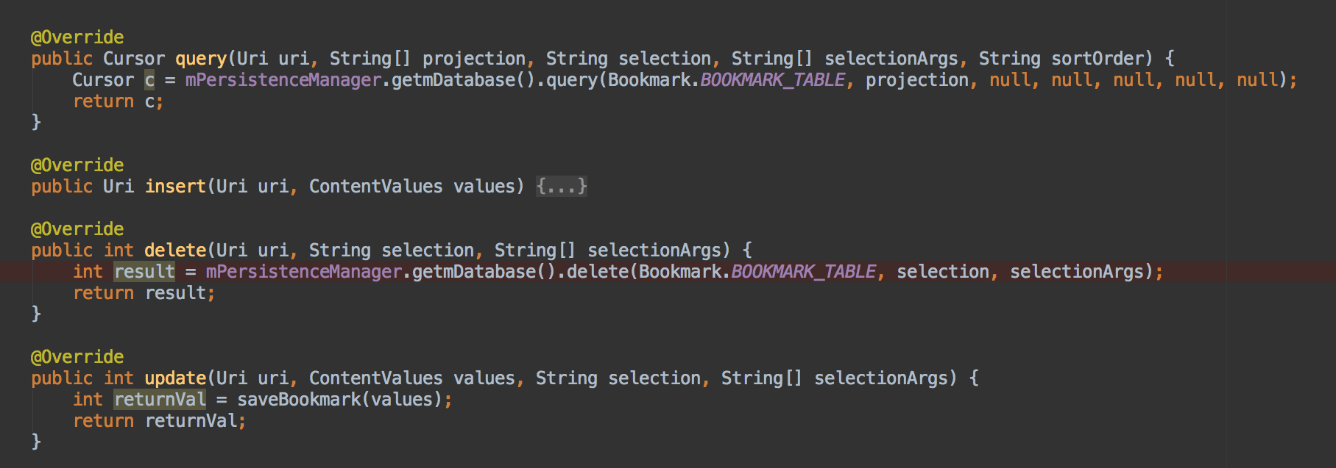
Content Providers
Encapsulate data and provide it to applications through the single ContentResolver interface.
Sharing data across apps
System inspects the URI received through the Content Resolver and passes it to the appropriate ContentProvider
What if I don’t want to share data with other apps? Do I need to use a content provider to access Sqlite DB? No. (CursorLoader does need it. Custom loaders may not.)

Slide 17
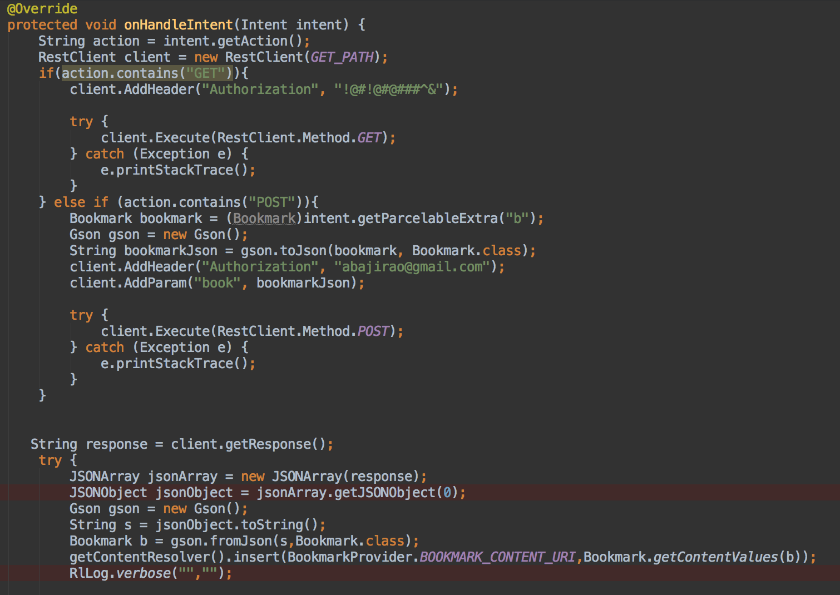
Servicing your app
Android Services for long running tasks
Network calls can outlast the activity

Slide 18
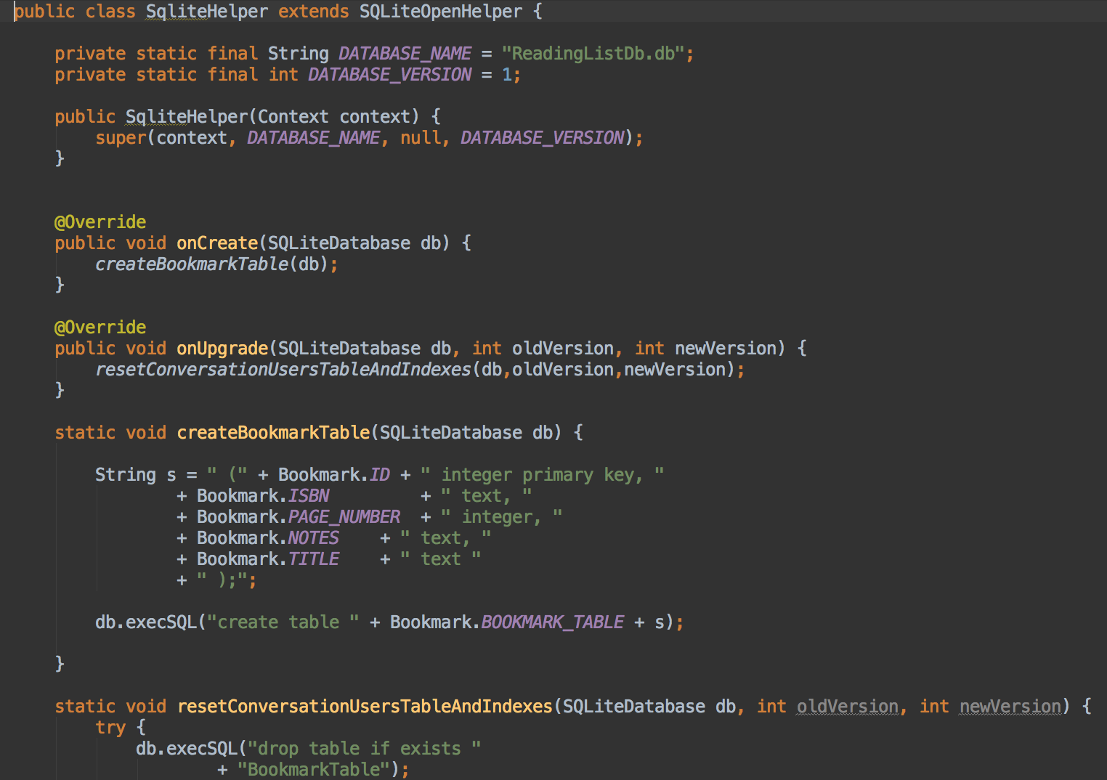
We’re all about persistence
Android SQLite database

Slide 19
Sync Adapters
Improved battery performance
Manage and automate data transfers, and coordinates synchronization operations across different apps
Create the SyncAdapter class
Bind the Sync Adapter to the Framework
Bind the Sync Adapter to the Framework
To plug your sync adapter component into the framework, you need to provide the framework with metadata that describes the component and provides additional flags.

Slide 20
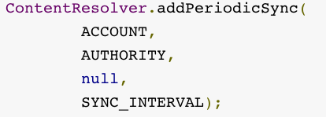
When do we sync data?
Sync data when the data on the server changes (GCM)
Local device data changes
When the system sends out a network message
TCP/IP connection is open so might as well sync
setSyncAutomatically()
System sends a message to all apps’ content providers
Time Interval driven sync
User sync
Manual refresh

Slide 21
“More” Android stuff…

Slide 22
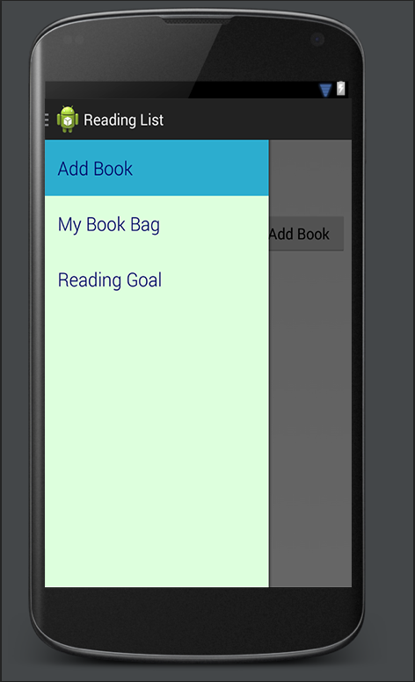
Navigation Drawer
Declare your user interface with a DrawerLayout object as the root view of your layout.
Add one view that contains the main content for the screen.
Add another view that contains the contents of the navigation drawer.

Slide 23
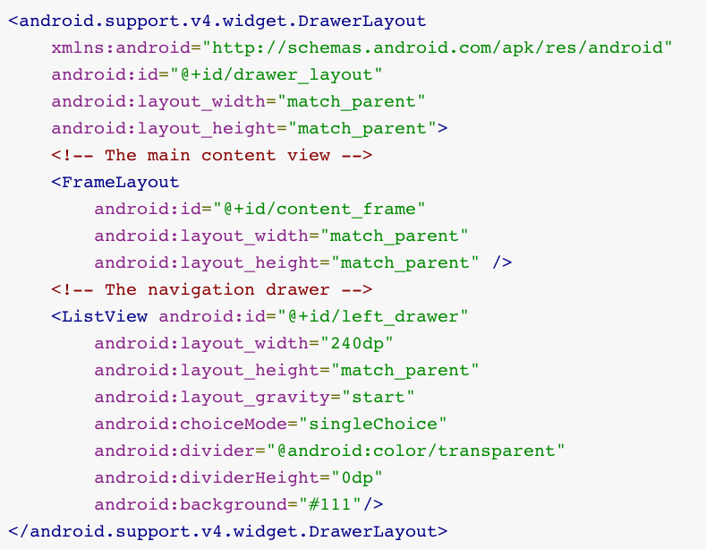

Slide 24
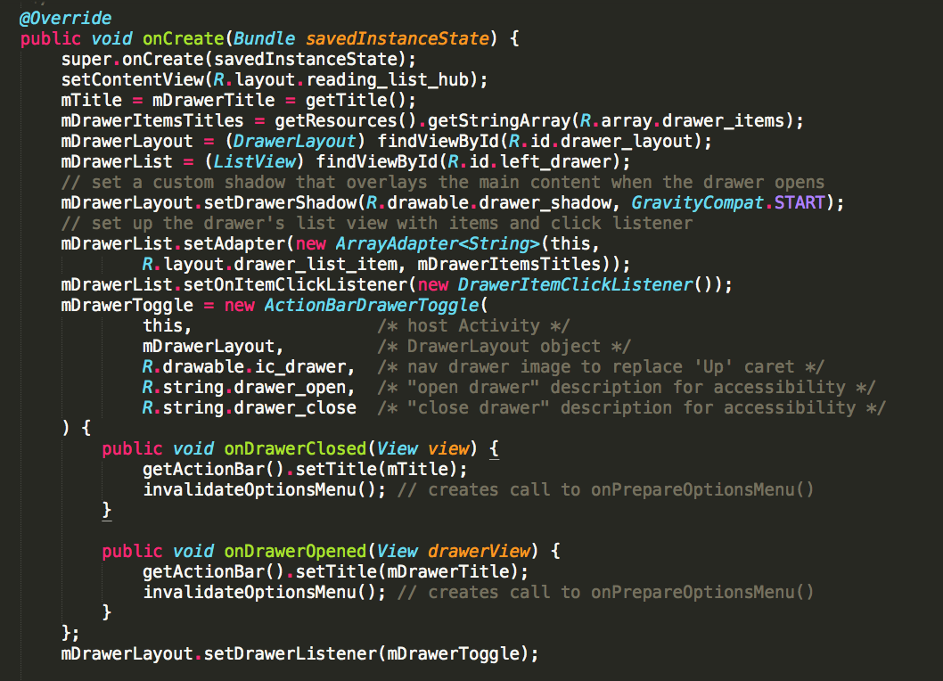

Slide 25
RoboGuice
Dependency injection framework for Android
https://github.com/roboguice/roboguice

Slide 26
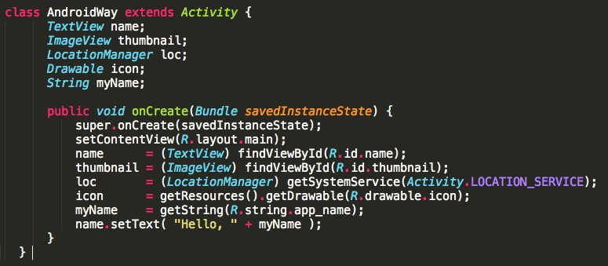
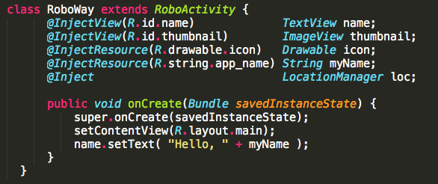

Slide 27
Bandwidth is not free ! Battery life is important !!!
Download only data that is important to the user
Be a good android citizen and share the network
Use Gzip
Batch your calls
Use the SyncAdapter to sync your app
Long bursts are better than short bursts
ATT ARO – for profiling

Slide 28
Common pitfalls
Passing data to fragments
Avoid passing via constructor params. Use bundle args instead
Remember to create the empty constructor for fragments.
When using listviews, remember to use the convertview for view recycling
Inflating XML is expensive
Prefer the ViewHolder pattern

Slide 29
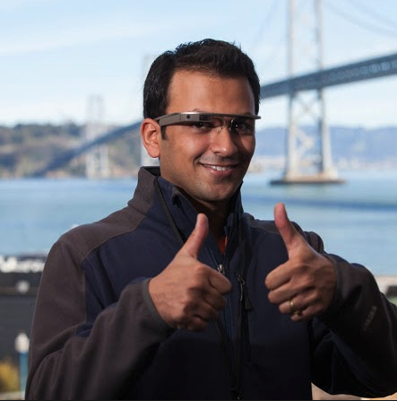



Thank you
Aniruddh Bajirao
Google+: http://goo.gl/GwbGX9
Twitter: @abajirao
Github: https://github.com/abajirao/readinglist-babbq

